Slide 1
Data Visualization & Leadership
Submitted by: Maisha Khatoon
Student ID: 100899259
Assignment 2

Slide 2
Summary
The dataset provides information on the demographic and socioeconomic characteristics of individuals, such as their educational attainment, gender, occupation, relationship status, and race, and financial indicators such as weekly working hours and capital gains/losses. The primary findings are summarized as follows: The majority of individuals have either attained a high school diploma or have pursued higher education by completing some college coursework. The work market exhibits a diverse range of occupations, with executive-managerial and professional-specialty roles being the prevailing ones. While a few individuals see substantial gains or losses in capital, the majority do not encounter either. There is a slight gender imbalance in the representation of males and females. These observations provide a comprehensive picture of the individuals included in the dataset and can serve as a foundation for further study on financial behaviors, rates of involvement in the workforce, and socioeconomic disparities among different demographic groups.

Slide 3
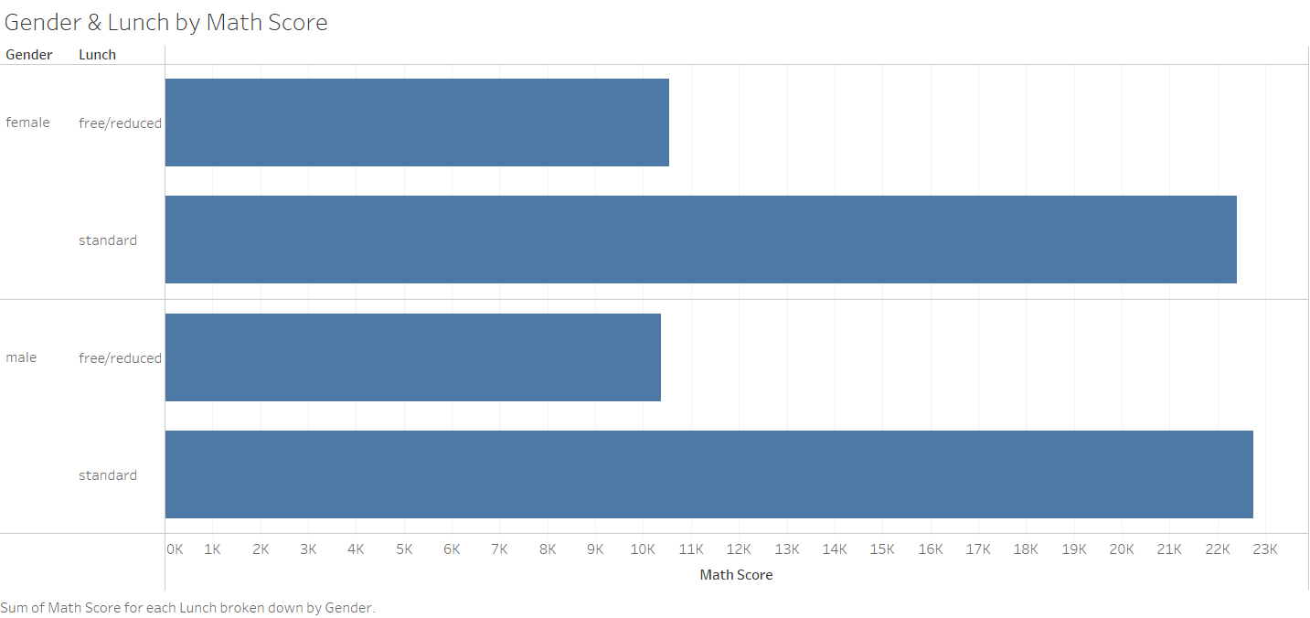

Slide 4
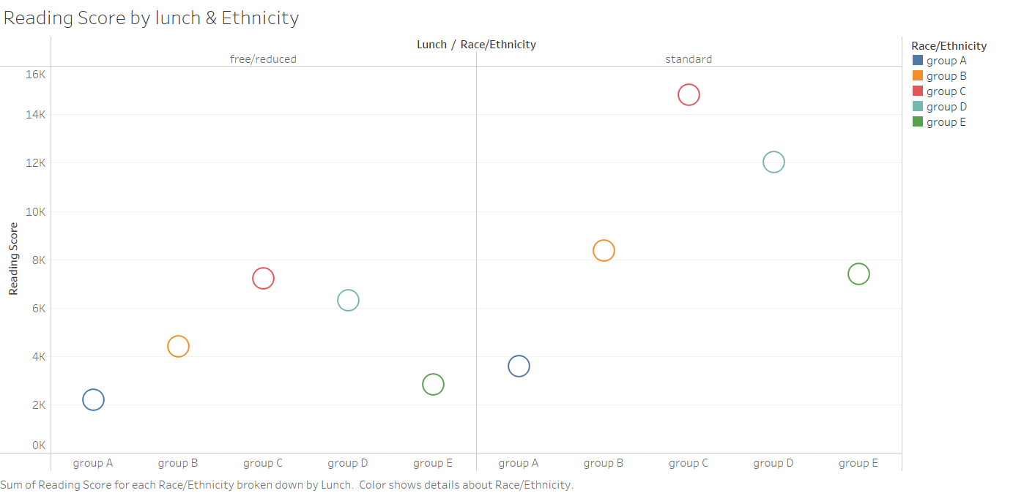

Slide 5
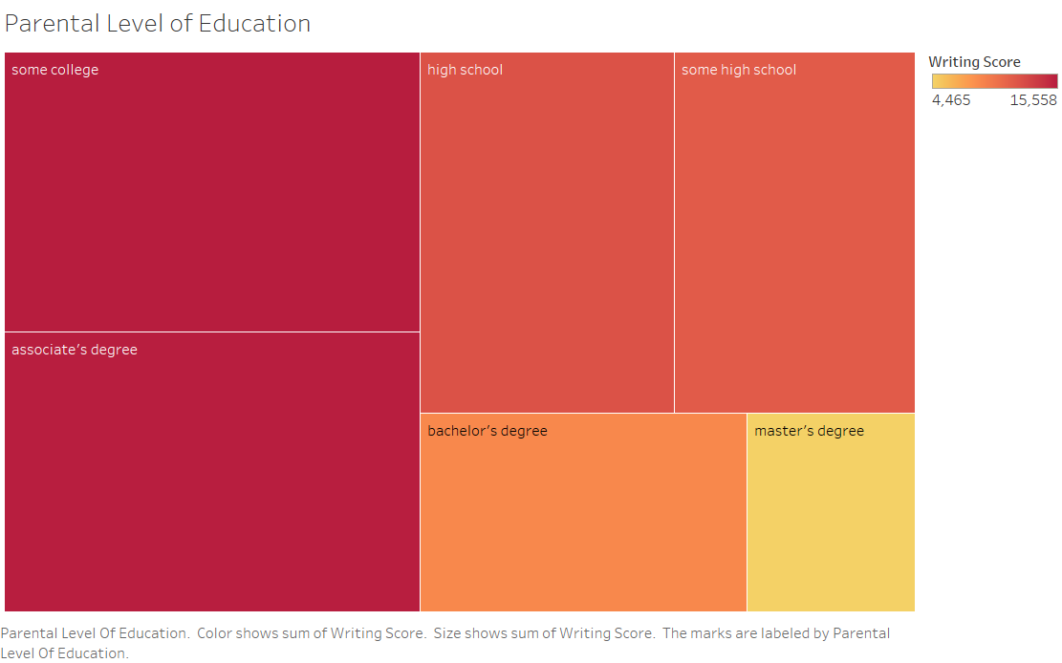

Slide 6
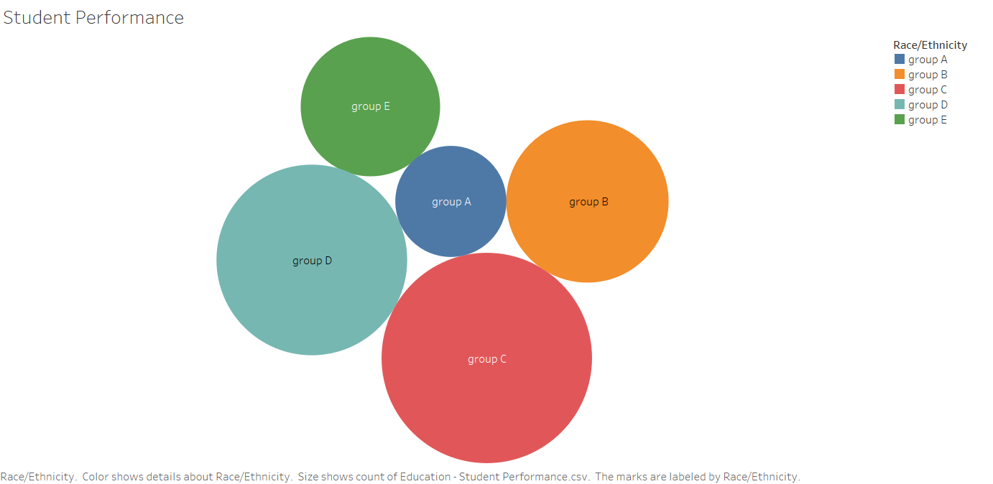

Slide 7
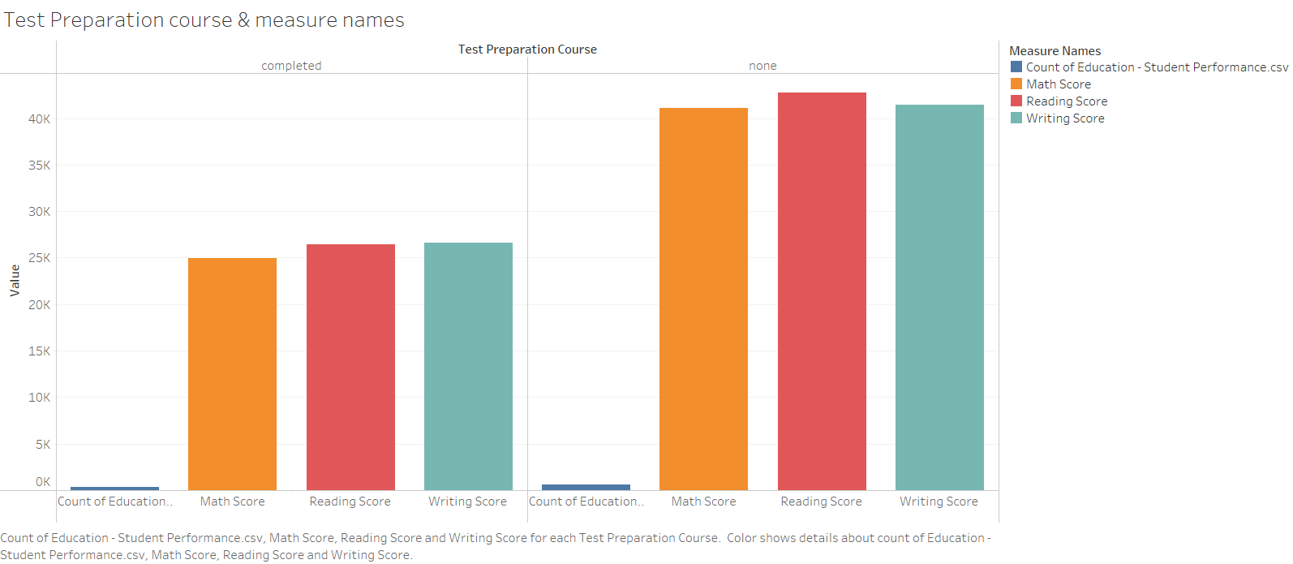

Slide 8
